Slide 1

Qingdao University
FBI-Denoiser: Fast Blind Image Denoiser
for Poisson-Gaussian Noise
《人工智能》论文答辩
指导老师：杨环 组长：李庆森 组员：王浩 董银昊

Slide 2
THE MAIN CONTENTS
01
背景与解决方案
02
经验与前人模型
03
创新与主要算法

Slide 3
1
第
部分
背景与解决方案
“站在巨人的肩膀”

Slide 4
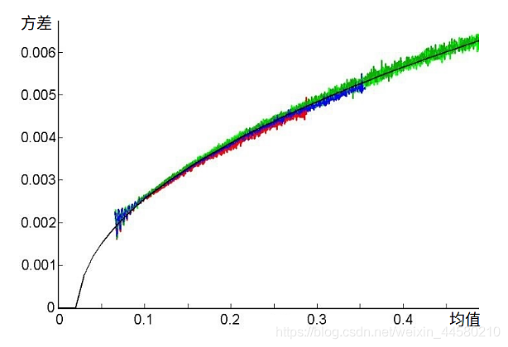
01 背景与解决方案
一、关于blind denoising
We consider the challenging blind denoising problem for Poisson-Gaussian noise:
No additional information about clean images
And noise level parameters is available.
噪声模型
成像流程
光子->电子：光线通过镜头被CMOS传感器接收，发生光电效应产生电子。光子是离散的，到达的光子数会有随机的涨落。→泊松噪声
电子->电压：光电效应产生的微弱电荷量，需通过放大电路放大信号幅度电路固有的因素，如器件中电子的热运动等，会造成结果的不精确。→ 高斯噪声
电压->数字：连续的电压信号并不能被数字电路储存，因此通过ADC(模数转化器)转化为数字信号。→均匀分布噪声（去噪时不考虑）
补充：泊松-高斯噪声
图中展示了高斯泊松噪声的特点：
方差曲线随着均值增大而逐渐升高的部分即为泊松噪声；
而方差曲线上抖动的部分即为高斯噪声。

Slide 5
01 背景与解决方案
二、Traditional denoising method
不进行参数估计
假设噪声分布已知
（先验经验）
Note：
Despite above promising achievements, the plain supervised learning approach has a critical drawback in a more practical, real-world setting, since the availability of the enough number of the clean-noisy image pairs for training is sometimes a luxury that cannot be simply assumed.
参数估计
极大似然估计
去噪方法
wavelet-based
filtering-based
prior-based
Solution about blind denoising :
The first approach is to utilize unpaired clean images and generate synthetic noisy images to again carry on the supervised training with the generated pairs.
The second recent approach to remove the requirement of clean-noisy pairs is to train a denoiser solely based on noisy images.

Slide 6
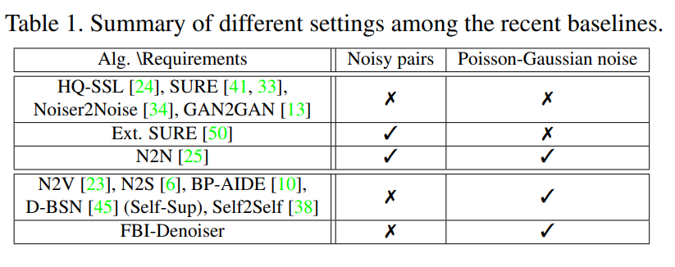
01 背景与解决方案
三、Neural network denoising method
method | drawback
clean and noisy image pairs | enough number of the clean-noisy image pairs for training is sometimes a luxury. 无充足的干净和噪声的图像对
unpaired clean images, generate synthetic noisy images | lack generalities 缺乏通用性
train a denoiser solely based on noisy images | large inference time due to requiring many number of samplings时间长，对真实噪声实验受限
BP-AIDE

Slide 7
01 背景与解决方案
三、最新研究成果： BP-AIDE
Generalized Anscombe Transformation (GAT) , Poisson-Gaussian noise estimation, and an unbiased estimator of MSE.
GAT变换，泊松-高斯噪声估计，无偏估计
However, BP-AIDE seriously suffered from slow inference time 缺点：推理时间慢
论文模型：FBI-Denoiser
BP-AIDE缺点原因 | FBI-Denoiser 改进
separately carry out the Poisson-Gaussian noise parameter estimation 单独执行噪声估计 | PGE-Net converting GAT and Gaussian noise estimation steps to tensor operations 将GAT变换和噪声估计转化为张量运算
simply utilizes the so-called blind-spot network (BSN) architecture proposed in [12] as a denoiser，the corresponding structure is quite complex 简单的使用BSN作为去噪器，模型复杂 | FBI-Net a new compact fully convolutional BSN 一个完全卷积BSN网络

Slide 8
2
第
部分
经验与前人模型
“站在巨人的肩膀”

Slide 9
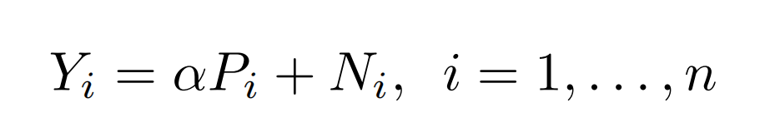
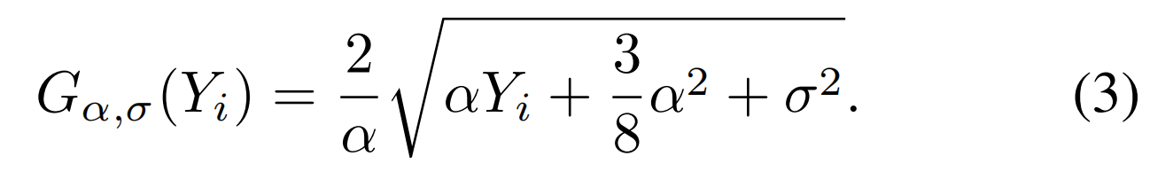
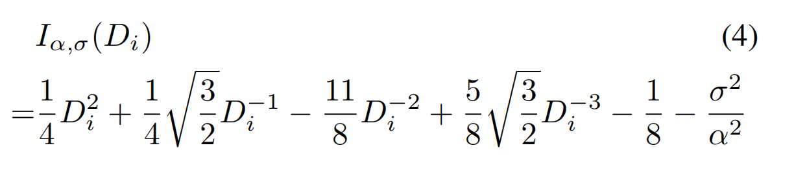
02 经验与前人模型
一、GAT 的简单介绍
泊松-高斯分布噪声 → 高斯分布噪声 （Yi > 0） Var=1
A general Gaussian denoiser can be applied to Gα,σ(Y) to obtain a denoised version D. Then, by denoting Di as the i-th pixel of D.
逆变换 → 去噪后的 Xi

Slide 10
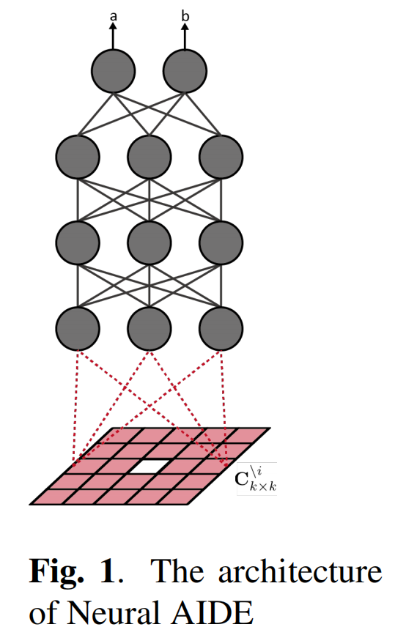
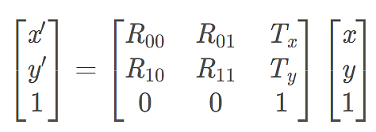
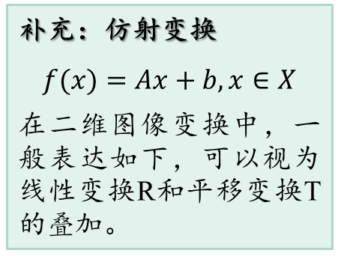
02 经验与前人模型
二、仿射变换与图像降噪
BP-AIDE combined GAT (3) and Poisson-Gaussian noise estimation methods, which estimates α and σ 2 of (1), with a pixelwise affifine denoiser.
整体思路
图像中的像素点并不是独立存在的，每一个像素点和周围的像素点都是条件相关的。其实这很容易理解，每一个像素点都和周围的像素点有着一定的关联。
基于此，我们的神经网络对于某个被污染的像素点通过观察其周围的像素点推断出被污染部分的真实值。
补充：仿射变换
$$f(x)=Ax+b,x∈X$$
在二维图像变换中，一般表达如下，可以视为线性变换R和平移变换T的叠加。

Slide 11
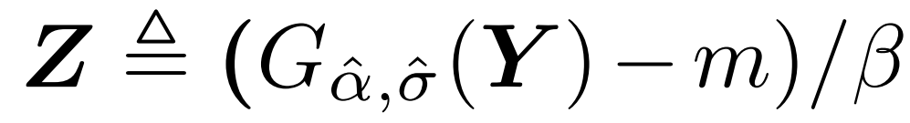
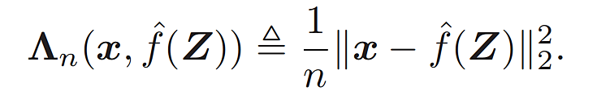
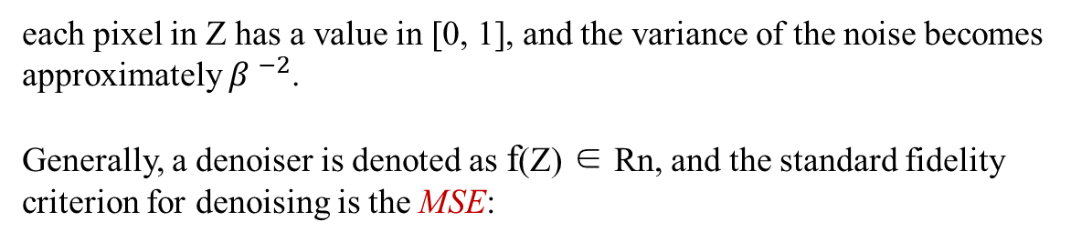
02 经验与前人模型
二、仿射变换与图像降噪
Unbiased Estimator of MSE for Pixelwise Affifine Denoisers
the normalized version of the transformed image:
max-min 归一化
each pixel in Z has a value in [0, 1], and the variance of the noise becomes approximately $β ^{−2}$.
Generally, a denoiser is denoted as f(Z) ∈ Rn, and the standard fidelity criterion for denoising is the MSE:

Slide 12
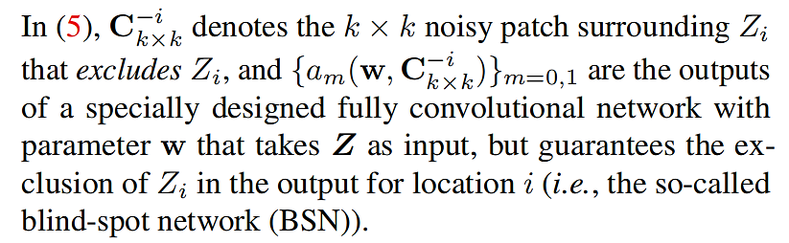

02 经验与前人模型
二、仿射变换与图像降噪
Unbiased Estimator of MSE for Pixelwise Affifine Denoisers
${C_{k×k}^{−i}}^{ } 除 Z$i 外 k*k大小的 patch
两个系数可看作斜率和截距，为卷积神经网络的输出

Slide 13
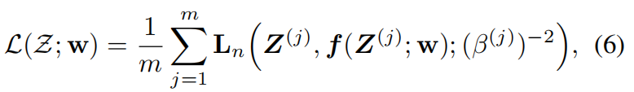
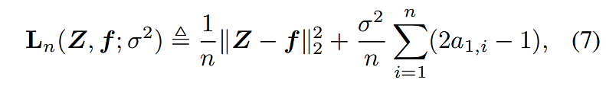

02 经验与前人模型
二、仿射变换与图像降噪
Unbiased Estimator of MSE for Pixelwise Affifine Denoisers
if the noise that generates Z is additive, independent, zero-mean
with homogeneous variance, e.g., AWGN, then (7) becomes an unbiased estimate of the mean-squared error (MSE) of f(Z; w) for estimating the underlying clean image.

Slide 14

02 创新与主要算法
二、仿射变换与图像降噪
II. Process of the BP-AIDE
Est + GAT
Training
Inference
Inference:
Once the training is done, when denoising a given test noisy image Yte at the inference time, the Est+GAT step is first applied to obtain Zte, then gets denoised by f(Zte, wBP-ADIE) in the transformed domain. Then, we apply the reverse of the normalization step in Est+GAT to obtain D and finally apply the IAT (4) with the estimated noise parameters (ˆα, σˆ) obtained in the Est+GAT step.

Slide 15
3
第
部分
创新与主要算法

Slide 16
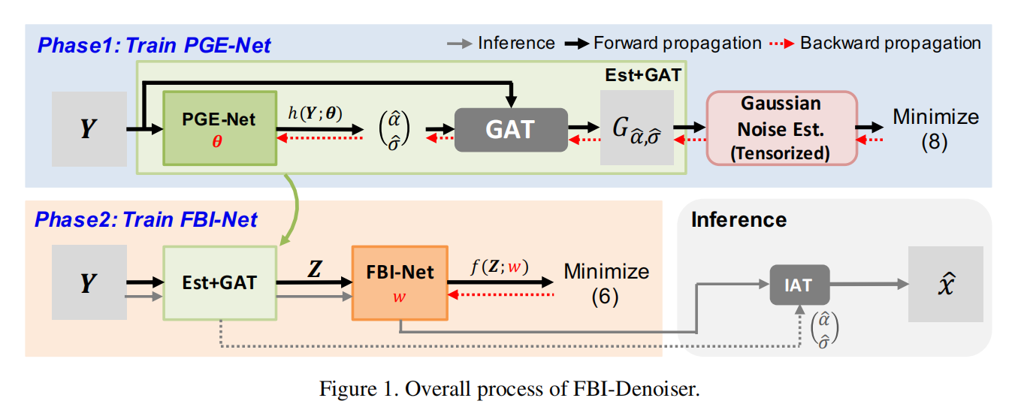
03 创新与主要算法
一、 FBI-Denoiser总体结构
主要创新点
PGE-Net：实现参数估计（加快速度）
FBI-Net：实现单一图像降噪（设计新的卷积核）

Slide 17
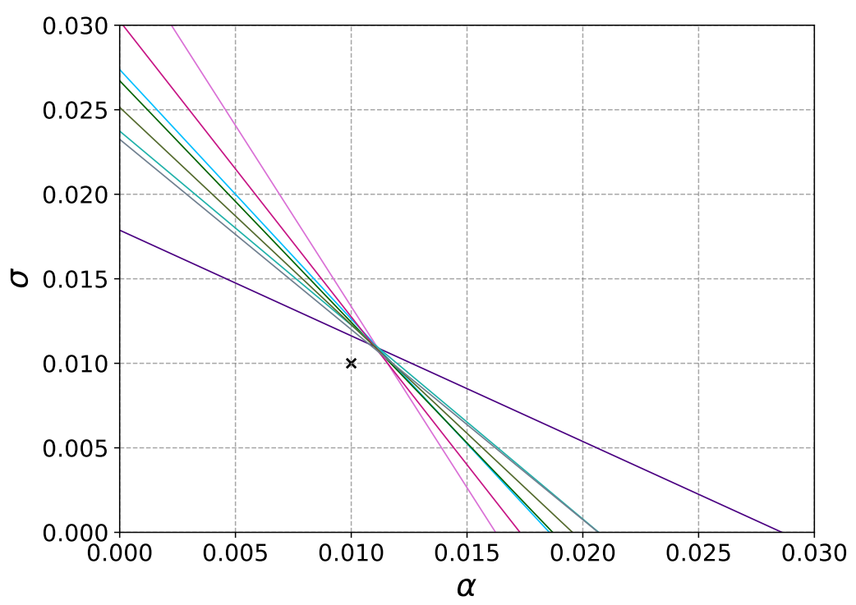
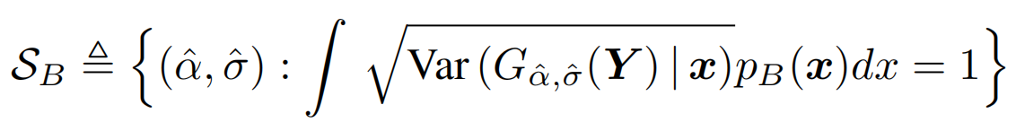
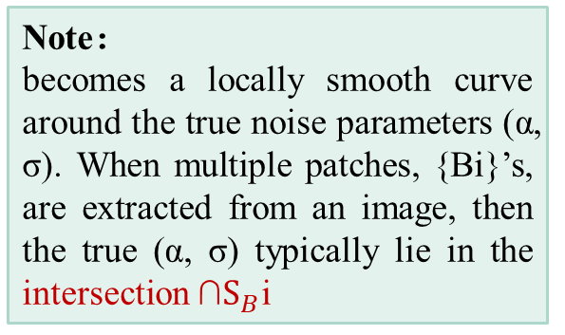
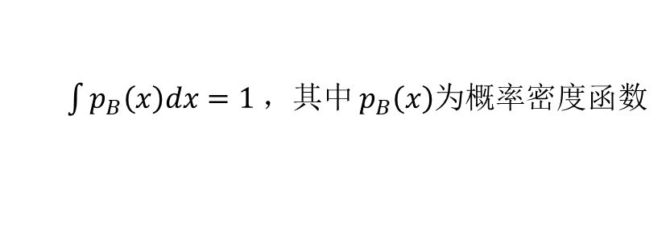
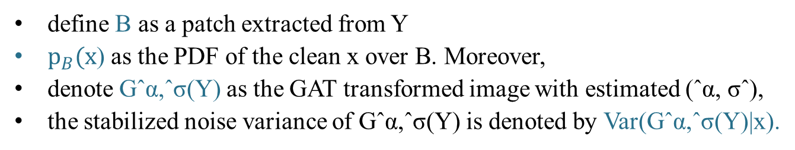
03 创新与主要算法
二、 PGE-Net：实现参数估计
Note：
becomes a locally smooth curve around the true noise parameters (α, σ). When multiple patches, {Bi}’s, are extracted from an image, then the true (α, σ) typically lie in the intersection $\text{∩}S_{B}\text{i}$
define B as a patch extracted from Y
$p_{B}(x$) as the PDF of the clean x over B. Moreover,
denote Gˆα,ˆσ(Y) as the GAT transformed image with estimated (ˆα, σˆ),
the stabilized noise variance of Gˆα,ˆσ(Y) is denoted by Var(Gˆα,ˆσ(Y)|x).
满足约束条件点(ˆα, σˆ)的集合：
概率密度函数定义域上积分恒为 1
estimate value
$\int{p_{B}\left(x\right)dx=1 ，其中}$ $p_{B}\left(x\right)$为概率密度函数
True value

Slide 18
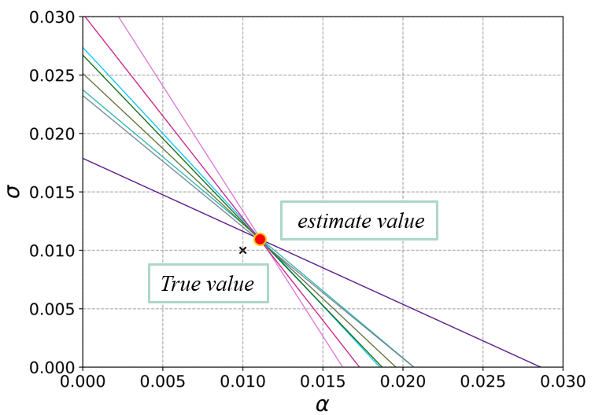
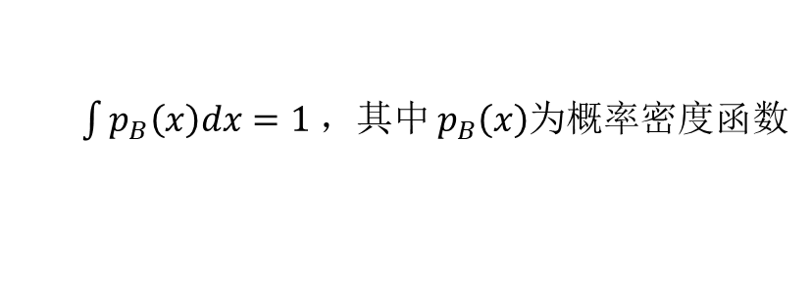
03 创新与主要算法
二、 PGE-Net：实现参数估计
Note:
This observation suggests that we can use patches from multiple noisy images and may learn a neural network model that can directly estimates the noise parameters (ˆα,σˆ) that make the noise variance of Gˆα,ˆσ(Y ) close to 1.
满足约束条件点(ˆα, σˆ)的集合：
使其值为1
概率密度函数定义域上积分恒为 1
$\int{p_{B}\left(x\right)dx=1 ，其中}$ $p_{B}\left(x\right)$为概率密度函数

Slide 19
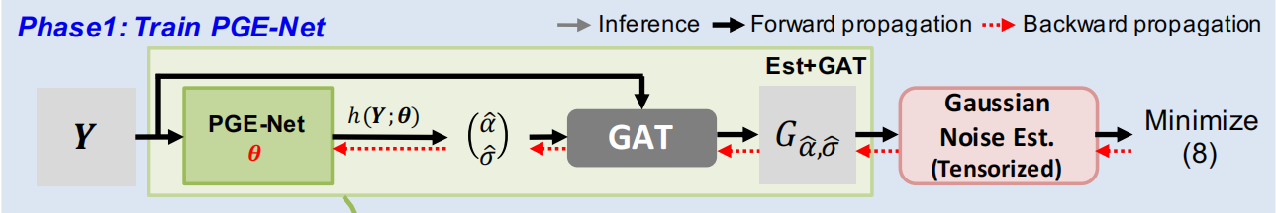
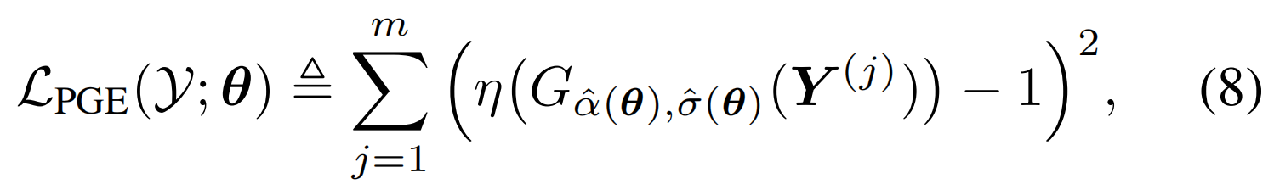
03 创新与主要算法
二、 PGE-Net：实现参数估计
We first define a neural network, h(·, θ) : Y → R2, that takes the Poisson-Gaussian noise corrupted image Y and outputs the noise parameter estimates ( ˆα, σˆ).
Moreover, we denote η(·) : Z → R as the function in [15] that estimates the Gaussian noise variance from an input image Z.
Given m distinct noisy images $\text{Y}\text{ = \{ }{Y^{(j)}\}}_{j=1}^{m}$, the loss function for our PGE-Net:
ˆα(θ) = h1(Y(j); θ) , σˆ(θ) = h2(Y(j); θ) are the estimated noise parameters (ˆα, σˆ) that are outputs of h(·, θ).

Slide 20
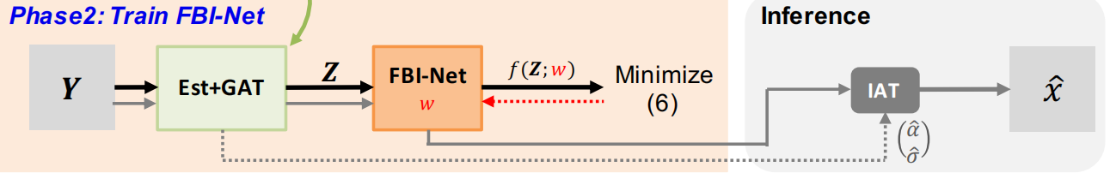
03 创新与主要算法
三、FBI-Net：实现单一图像降噪
Once the noise parameters (ˆα, σˆ) are estimated with PGE-Net, our denoising network FBI-Net is trained following the same training procedure of BP-AIDE.
Est + GAT
Training
Inference
Recall that the BSN architecture was necessary for implementing the pixelwise affifine denoiser (5) and maintaining the unbiasedness of (7), and we devise a more effificient BSN in this section.

Slide 21
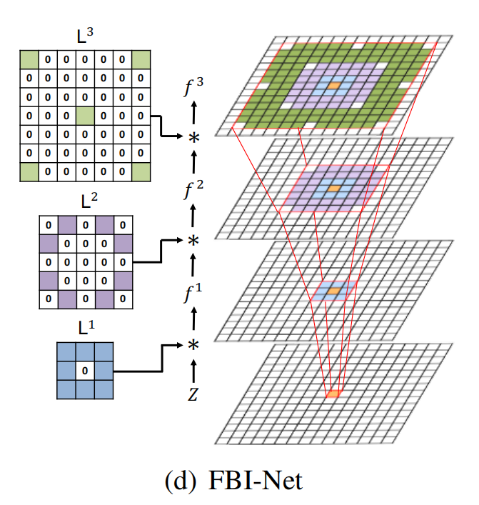
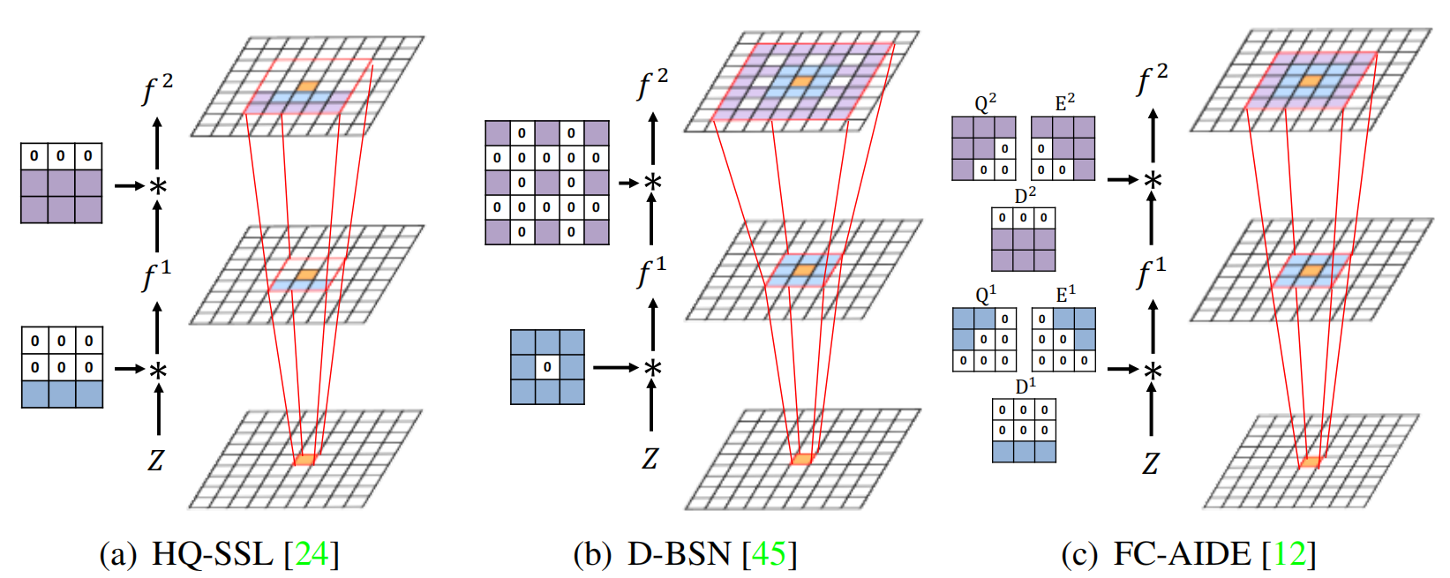
03 创新与主要算法
三、FBI-Net：实现单一图像降噪
L1 is a center masked 3 × 3 size of convolution layer which is equal with the first layer proposed in D-BSN.
L2 is 5 × 5 size of convolution layer which is all masked except for eight holes.
L3 is 7 × 7 size of convolution layer which only has weights at the center and each edge.

Slide 22
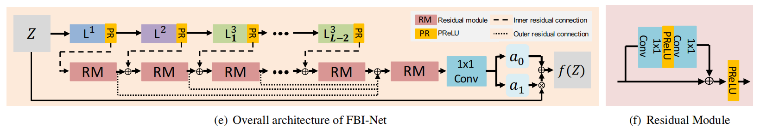
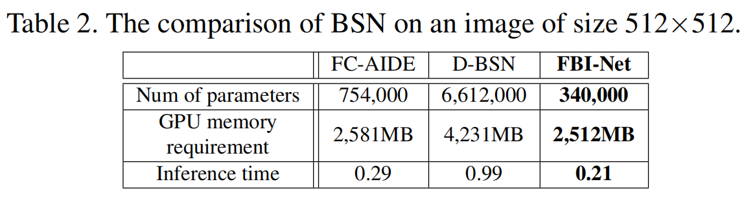
03 创新与主要算法
三、FBI-Net：实现单一图像降噪
We used PReLU for all activation functions and Residual Module (RM) proposed in Figure 3(f). To maintain the constraint, we only used 1 × 1 CNN layer for the output layer and RM. Note that we add two different residual connections denoted by Inner and Outer residual connection.

Slide 23
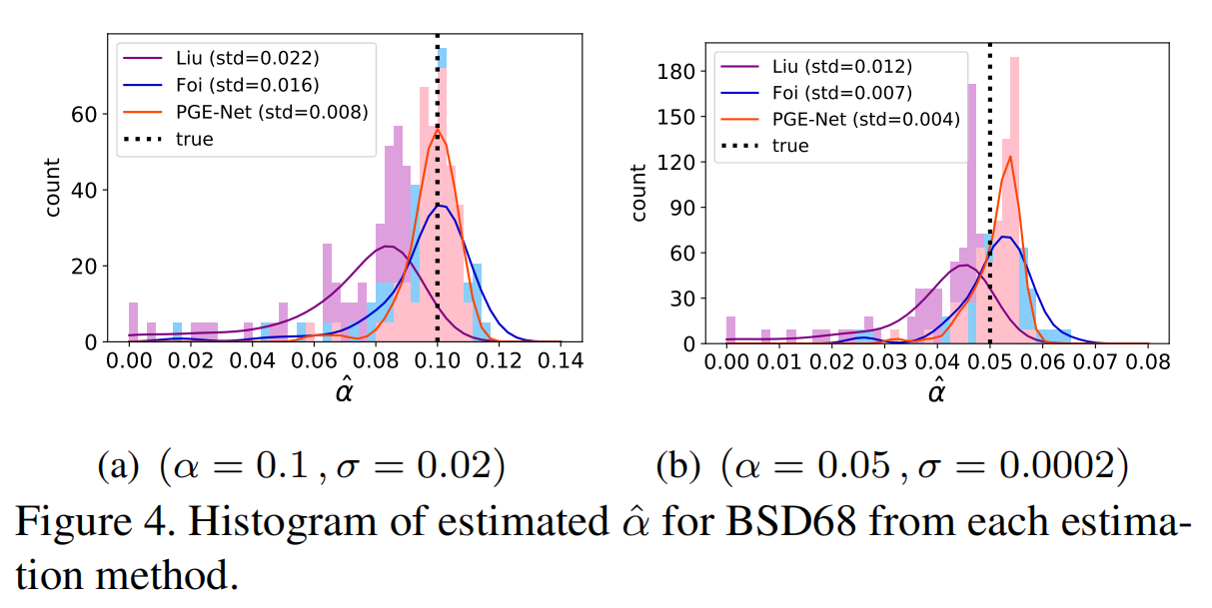
03 创新与主要算法
四、实验结果
Note:
We first compared the accuracy of the noise parameters from PGE-Net (phase 1) with two representative baselines: Foi and Liu. Then, we compared the overall denoising performance of FBI-Denoiser with following baselines: GAT+BM3D [17], N2V [23], D-BSN [45],and BP-AIDE [10]. GAT+BM3D is a traditional method, but it is still a very powerful baseline for the Poisson-Gaussian noise denoising.

Slide 24
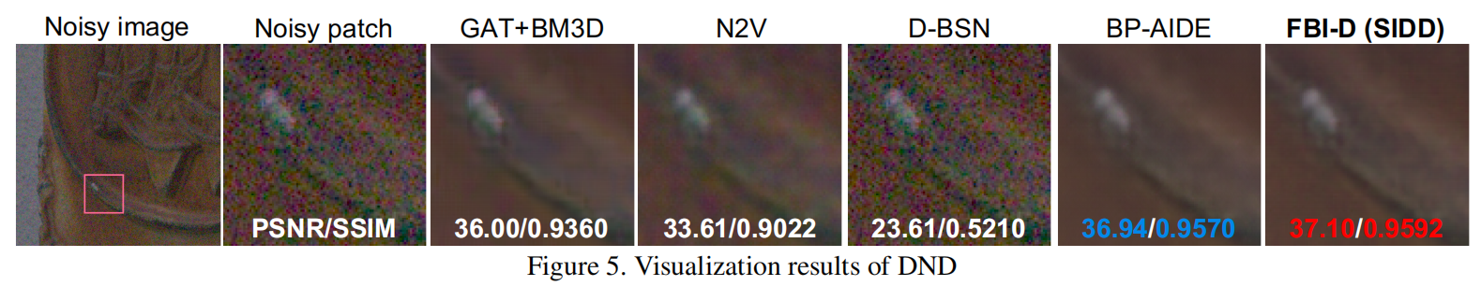
03 创新与主要算法
四、实验结果
Note:
Then, we compared the overall denoising performance of FBI-Denoiser with following baselines: GAT+BM3D, N2V, D-BSN, and BP-AIDE. GAT+BM3D is a traditional method, but it is still a very powerful baseline for the Poisson-Gaussian noise denoising.
代码实现

Slide 25
Qingdao University
谢谢观看
指导老师：杨环 组长：李庆森 组员：王浩 董银昊

